Slide 1
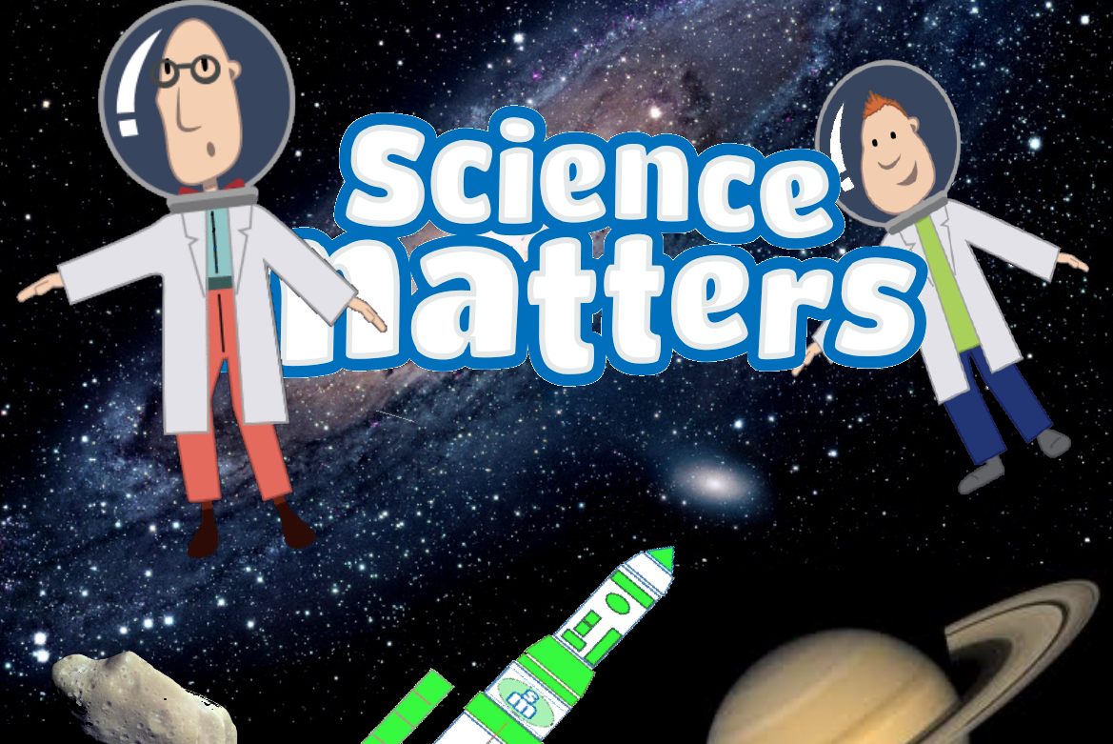
EARTH AND BEYOND

Slide 2
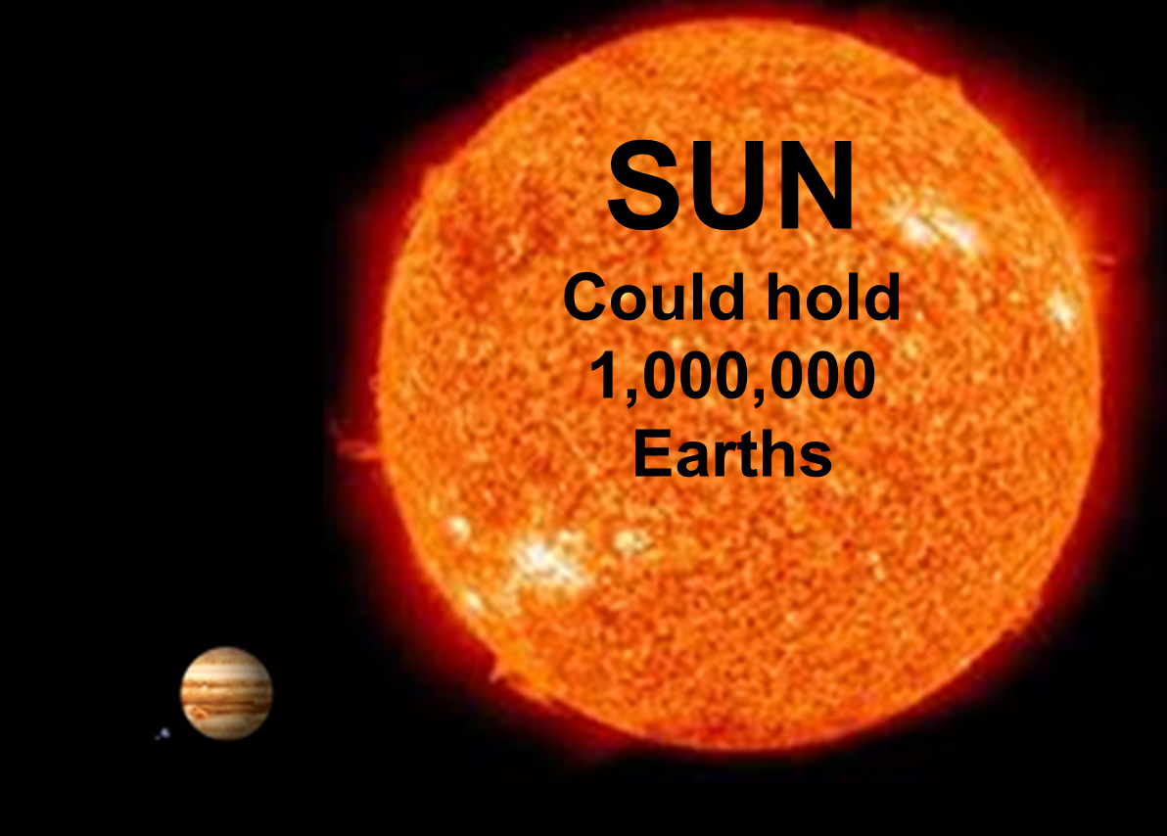
JUPITER
EARTH

Slide 3
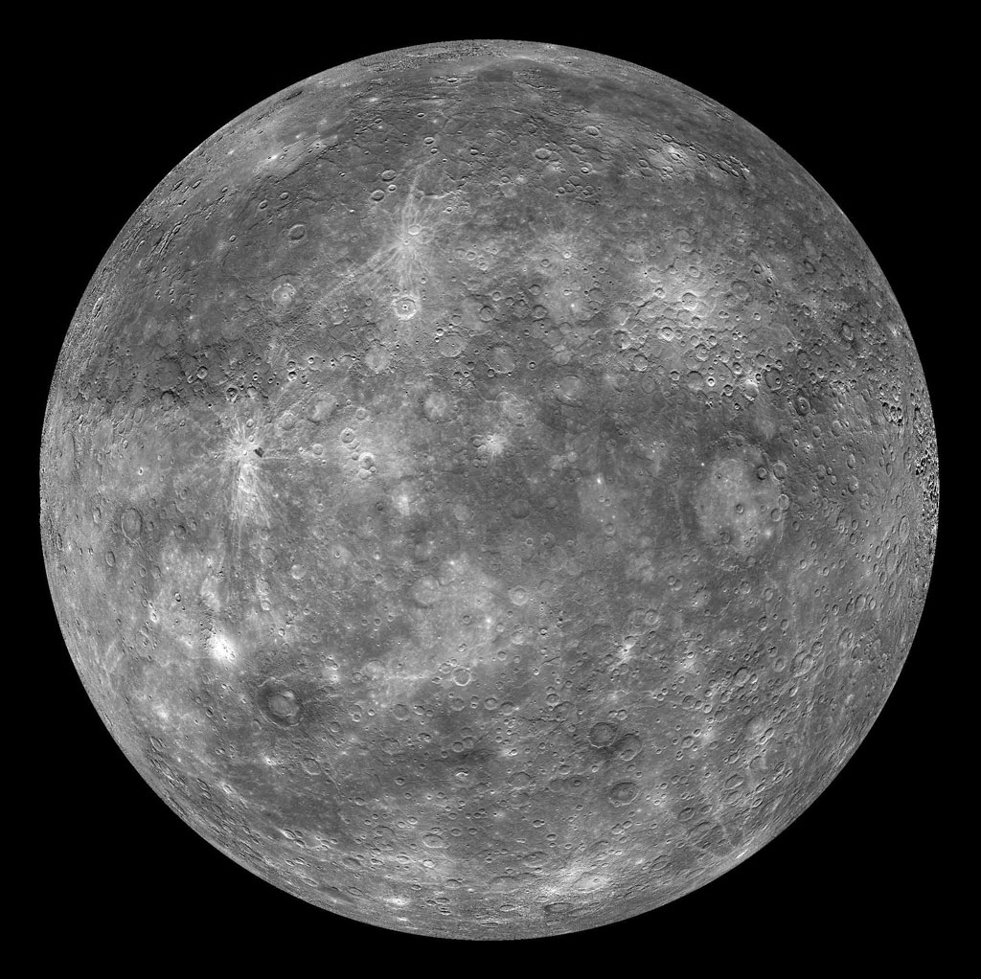
MERCURY

Slide 4
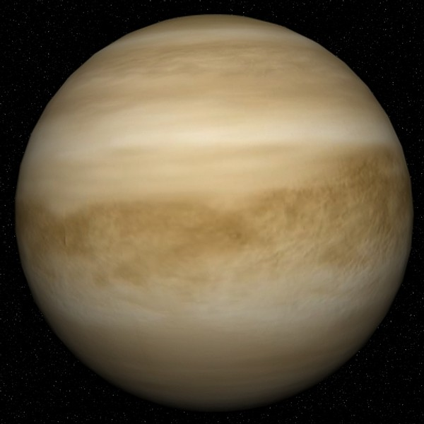
VENUS

Slide 5
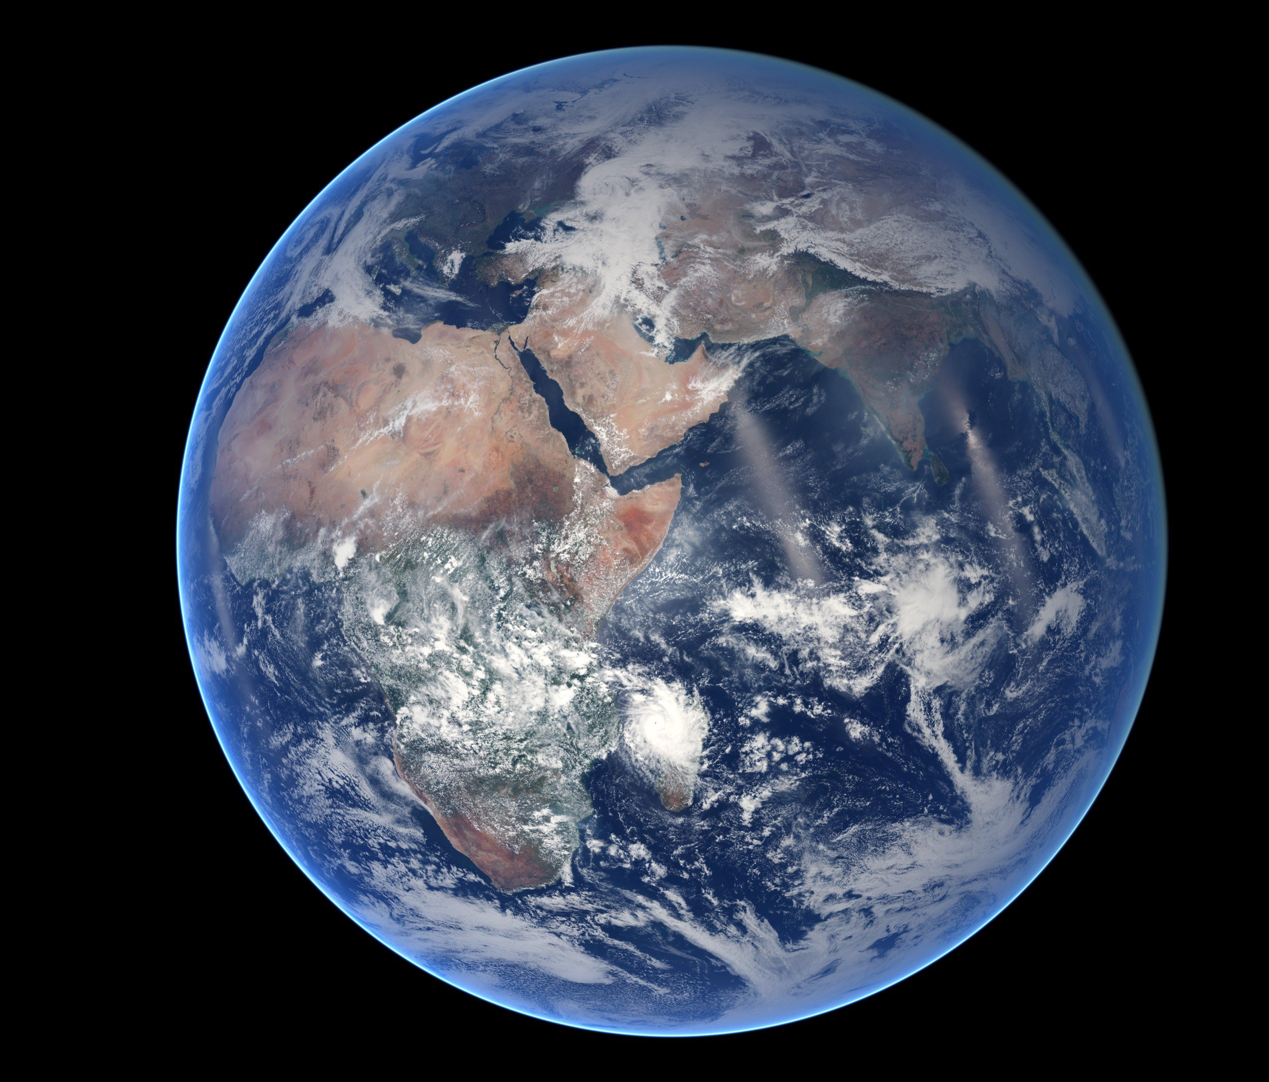
EARTH

Slide 6
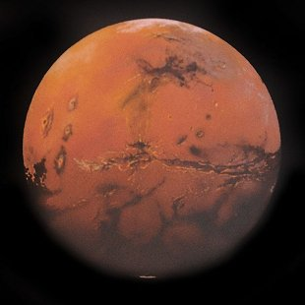
MARS

Slide 7
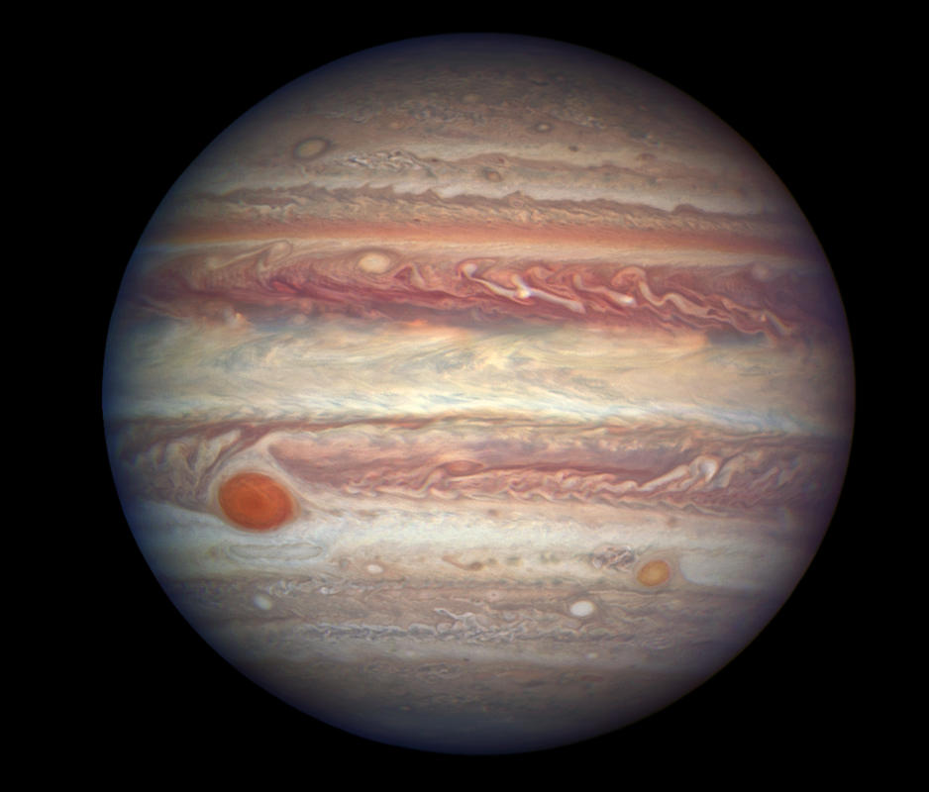
JUPITER

Slide 8
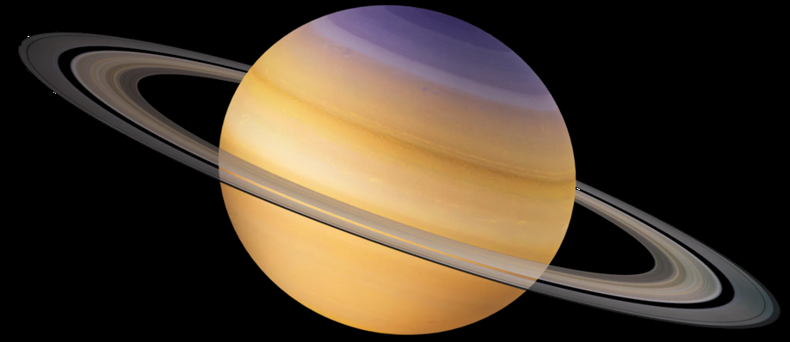
SATURN

Slide 9
URANUS

Slide 10
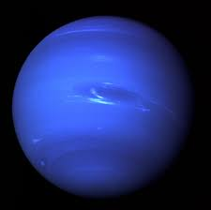
NEPTUNE

Slide 11
The Solar System
3500km
Moon
The Solar System
The Solar System

